Slide 1
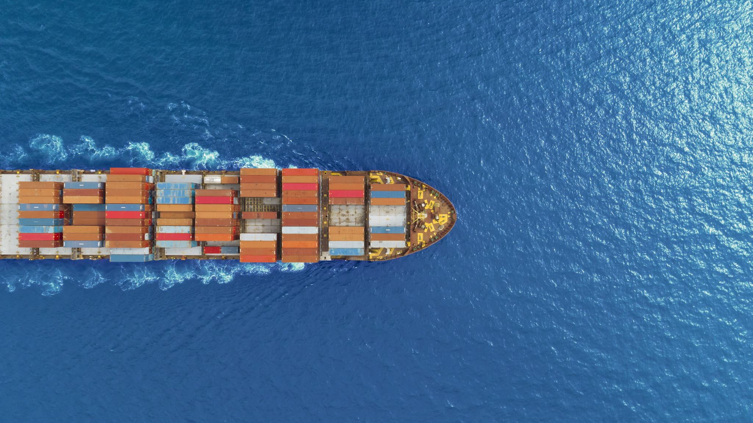
Canada’s Ocean Economy Haiku By Adam Hicks
Canadas's oceans, is the blue economy, livelihoods depend

Slide 2
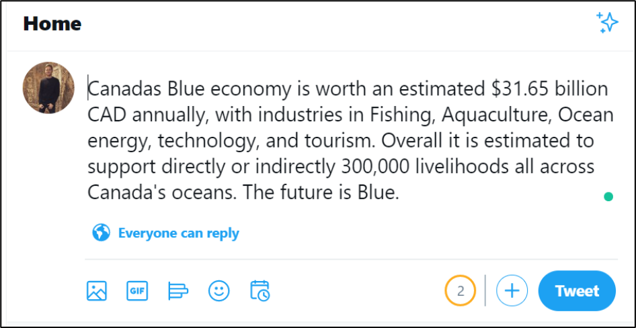
Canada’s Oceans economy By Adam Hicks@Adam_D_Hicks

